Slide 1
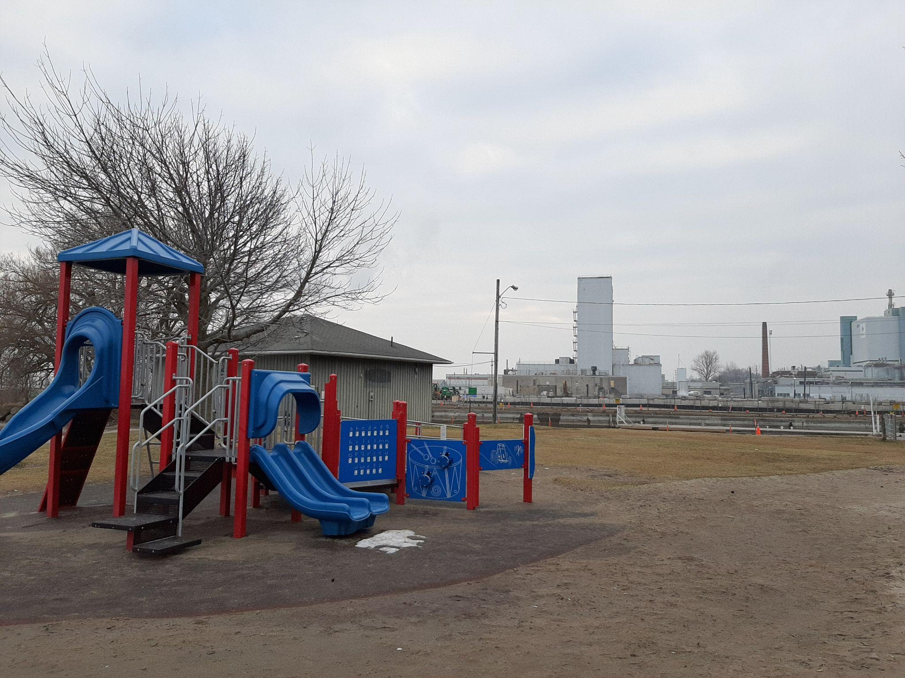
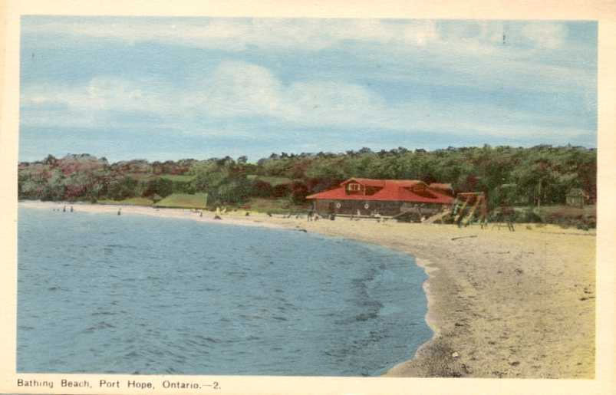
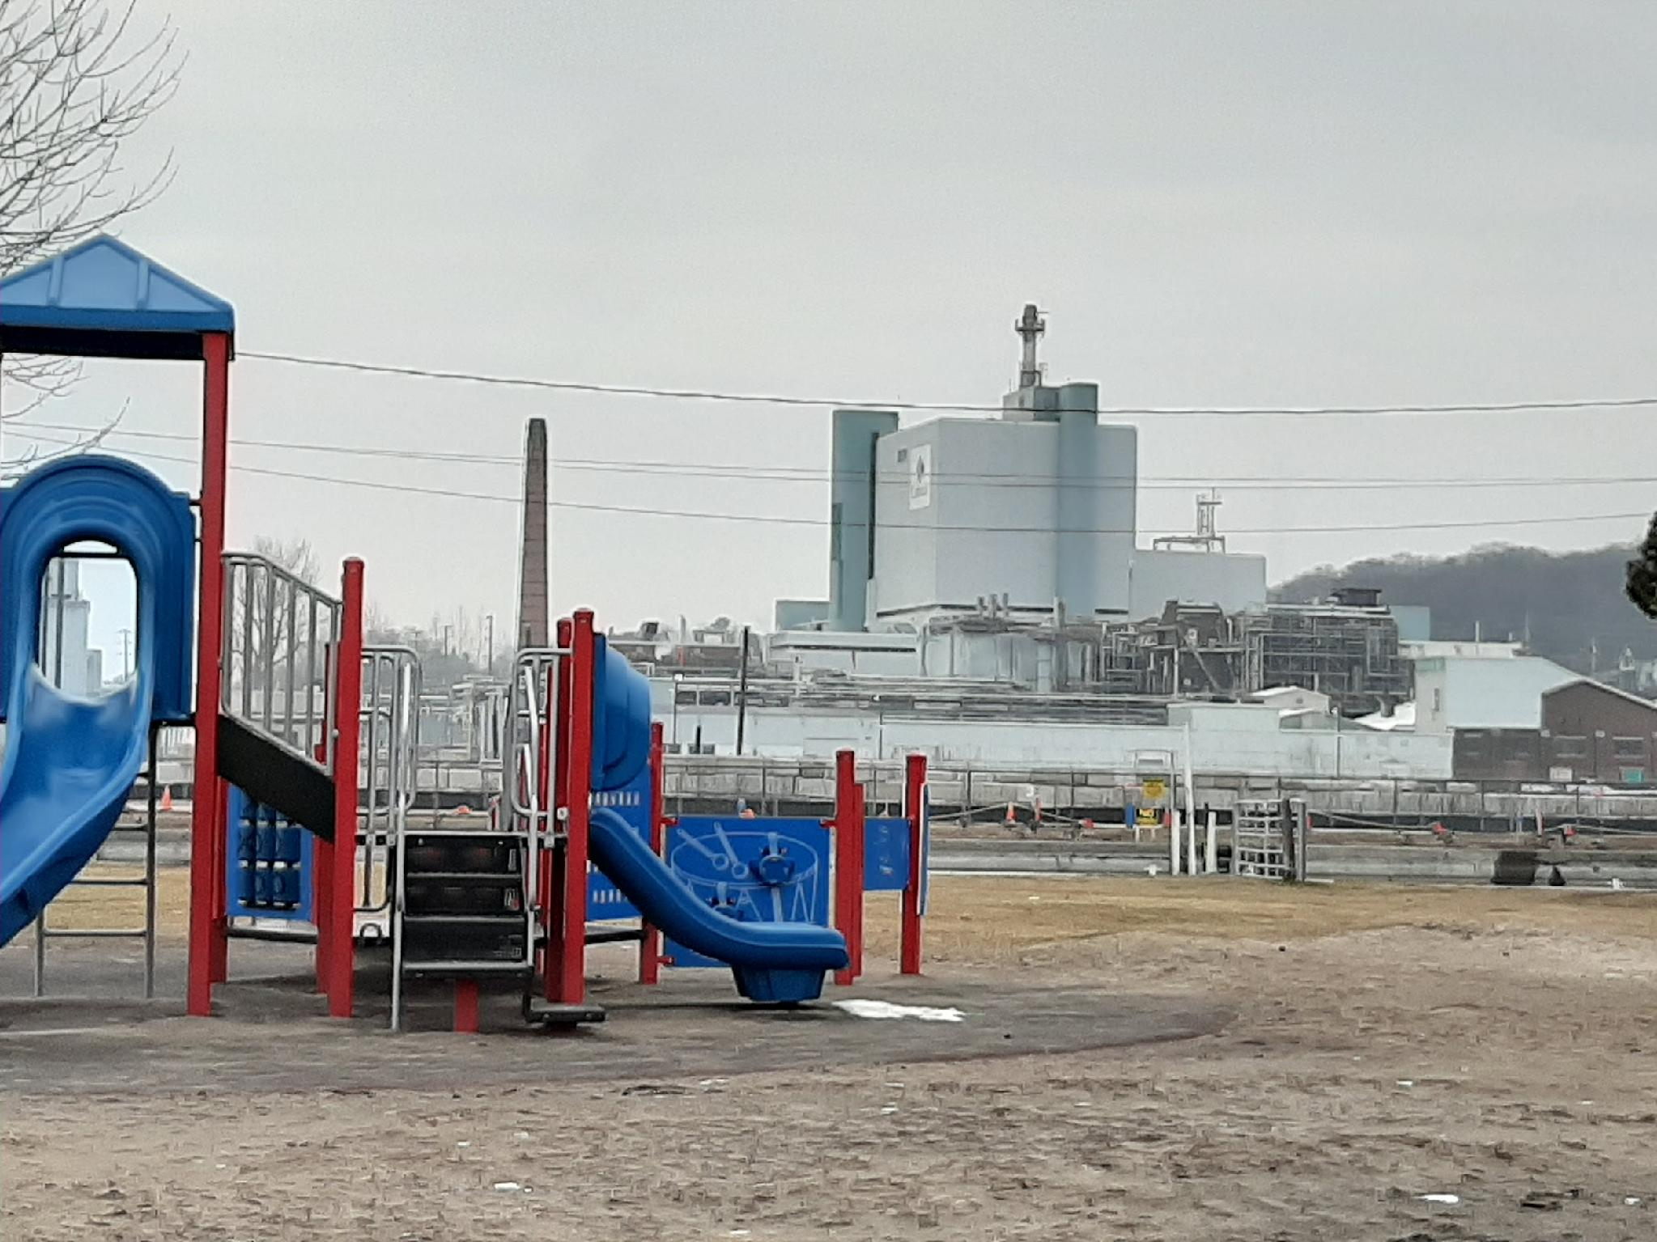
Nuclear Issues in Port Hope: Past, Present, Future
Public Meeting June 17, 2026
Nuclear Waste Watch sponsor
"Nuclear Neighbours"
Presentation February 16, 2023
Port Hope Community Health Concerns Committee
Presentation by Faye More
Port Hope Community Health Concerns Committee
‹#›

Slide 2
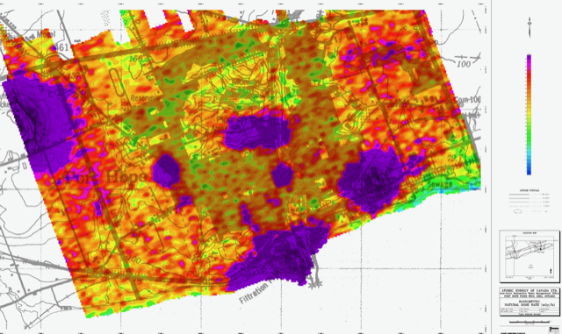
1976 federal aerial radiometrics survey of Port Hope
Natural Dose Rate nGy/hr received via AECL ATIP 2024

Slide 3
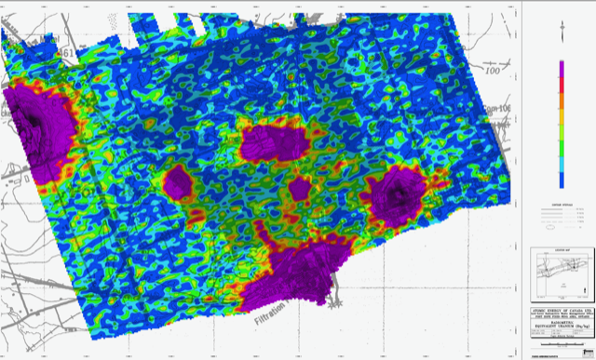
1976 federal aerial radiometrics survey of Port Hope Equivalent Uranium (Bq/kg) received via AECL ATIP 2024

Slide 4
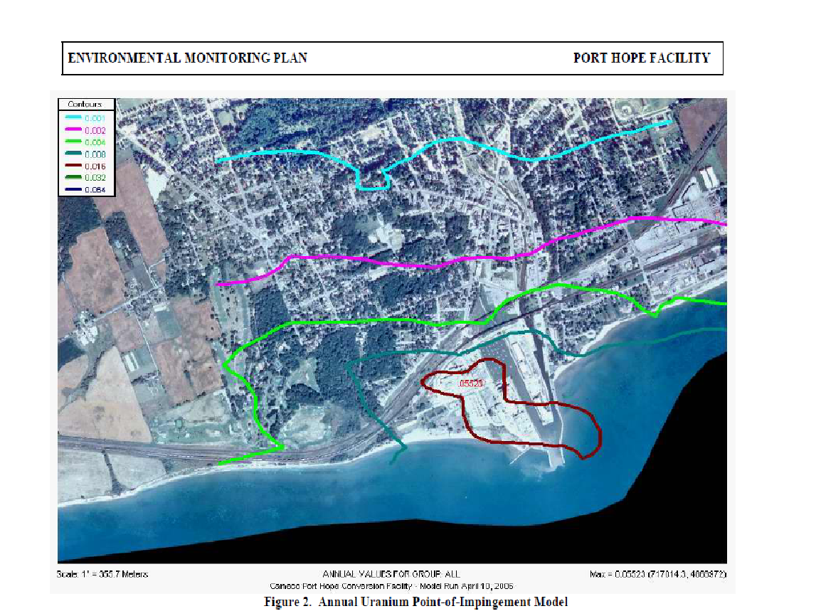
Cameco CF: Annual Uranium Point of Impingement Model
2005 Diagram/data from Cameco Monitoring Plan to show distribution pattern for uranium emissions
‹#›

Slide 5
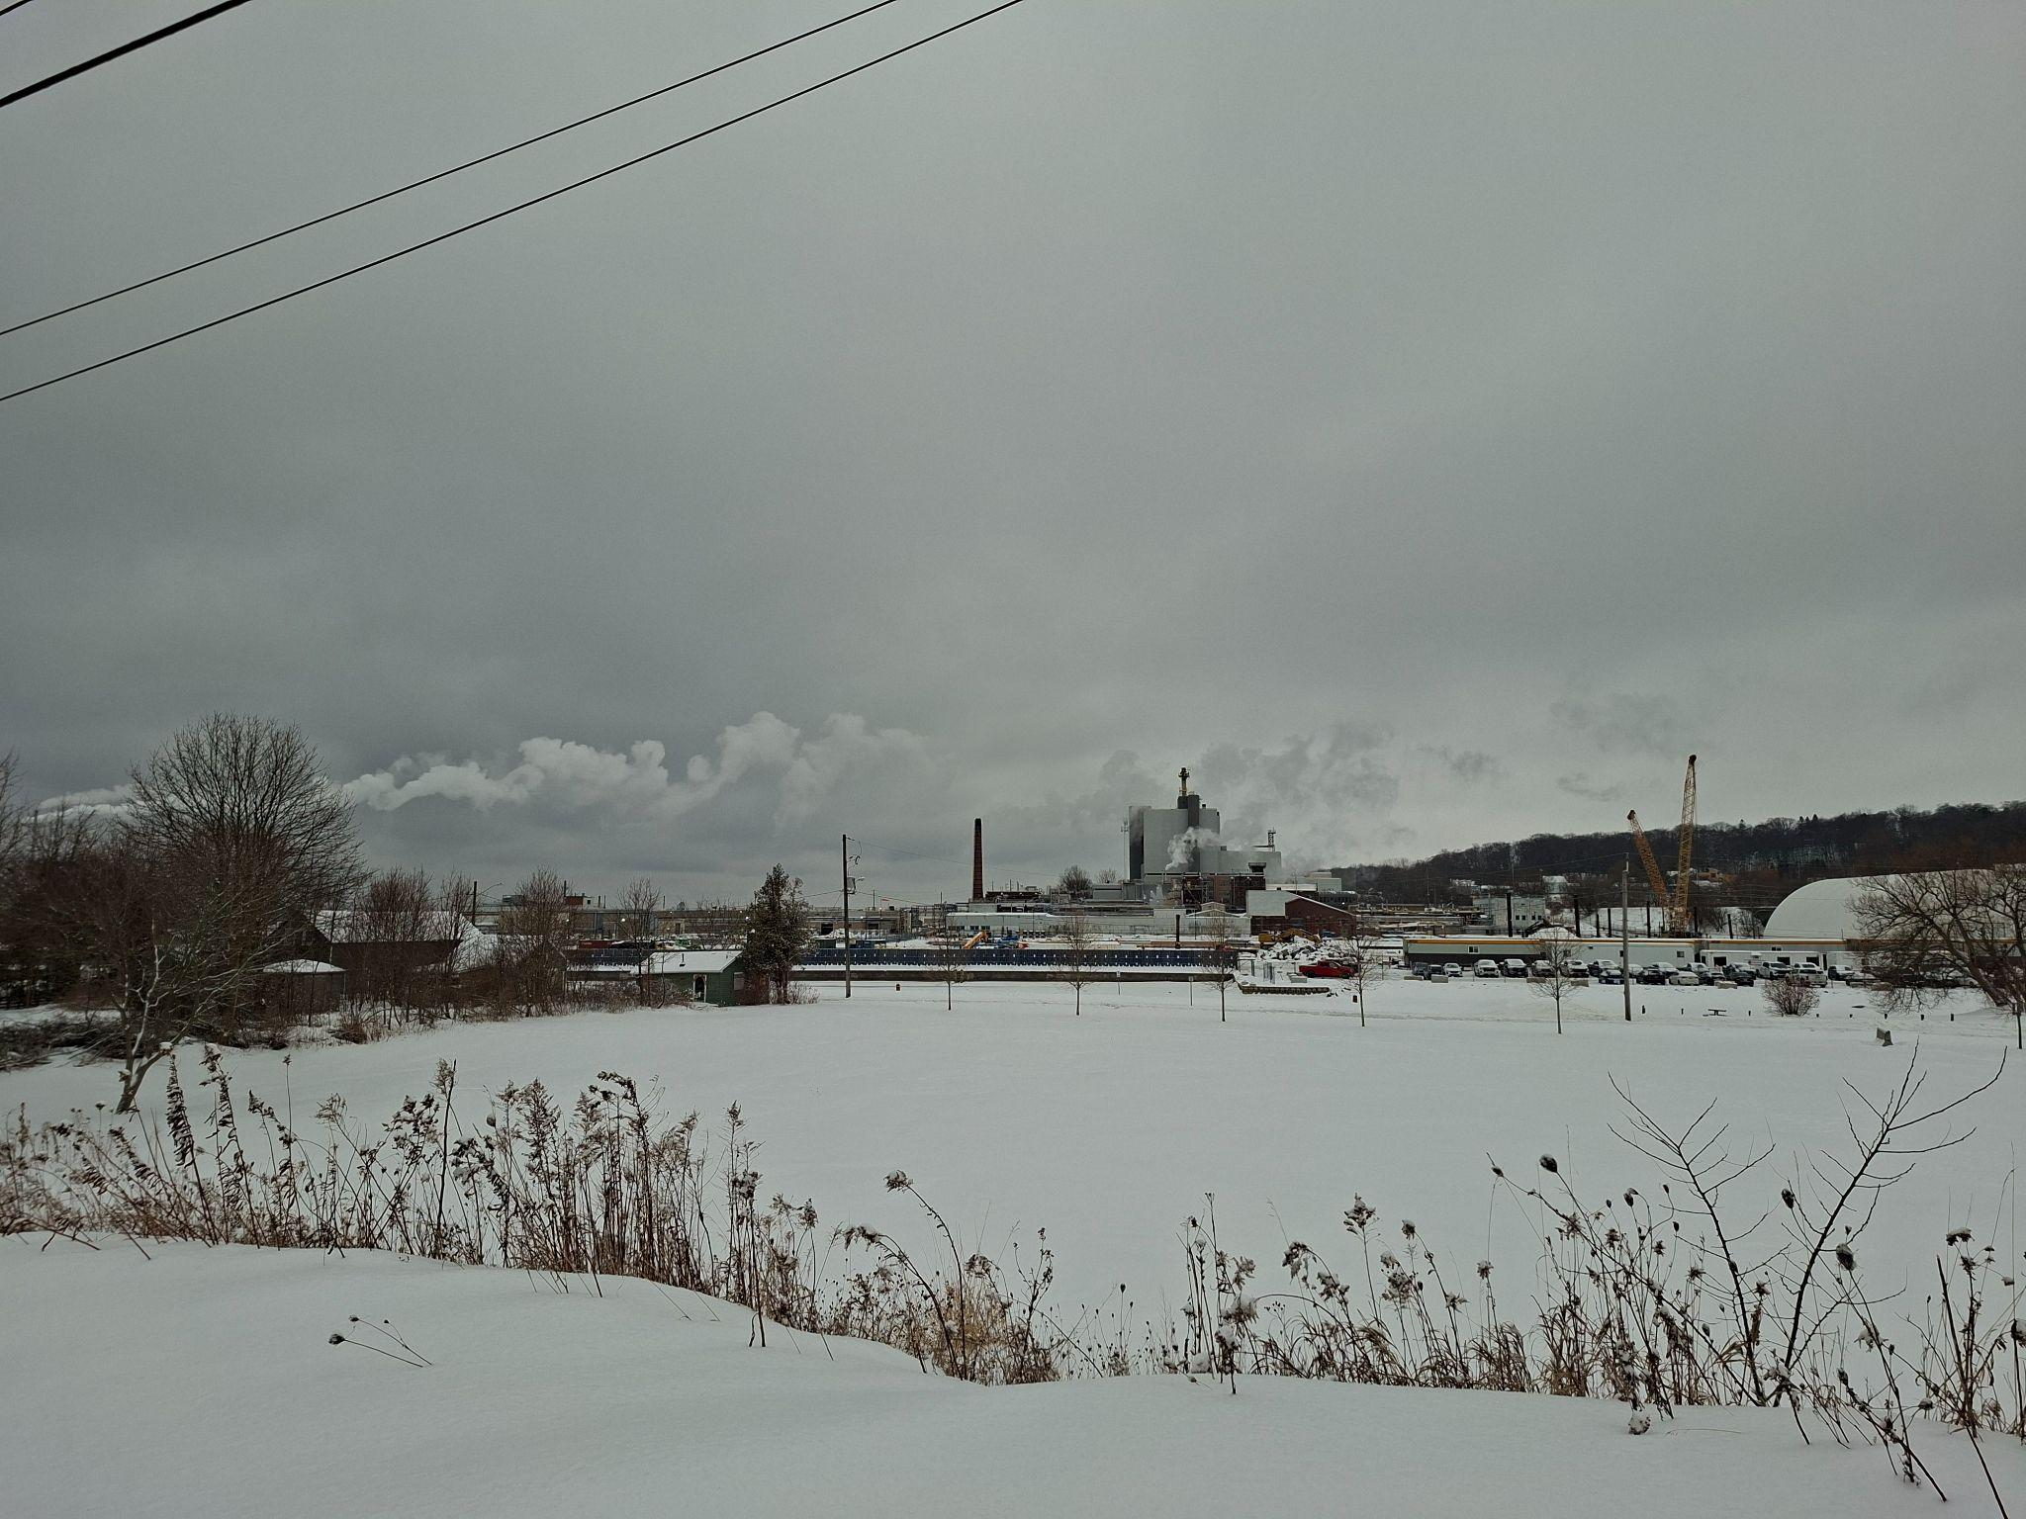
Cameco emissions February 10, 2026 north over town

Slide 6
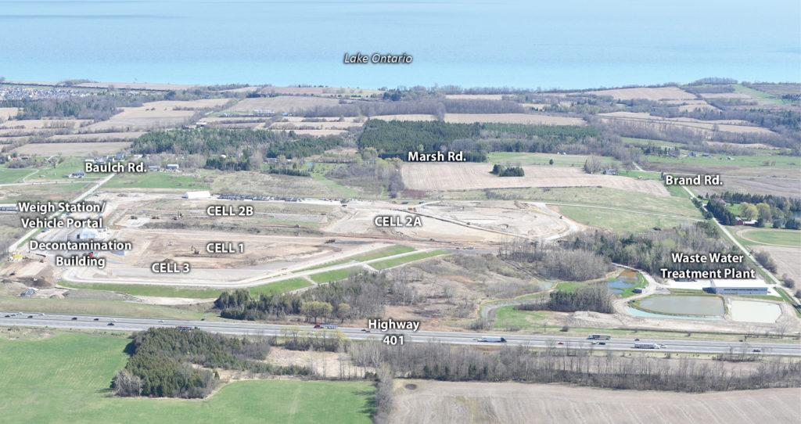
PHAI photo: New long-term storage facility location beside
Lake Ontario, no buffer zone from new homes, soccer fields

Slide 7
Science says “No Safe Level”
“There is no safe level of exposure and there is no dose of radiation so low that the risk of a malignancy
is zero”
--Dr. Karl Z. Morgan, founder and
dubbed the father of Health Physics.
Director of Health Physics at Oak Ridge
from 1943 to 1972.

Slide 8
3.3 Cleanup Criteria (Legal Agreement)
3.3.1 Contemporaneous to the construction of the new Facilities, Canada shall
clean up contaminated sites as follows:
(a) Canada shall clean up properties contaminated with Historic Low-Level Radioactive Waste so that all such properties will be able to be used for all current and foreseeable unrestricted uses.
(b) Through the cleanup process, other contaminants may be found
commingled with the Historic Low-Level Radioactive Waste, and in such
cases, Canada shall clean up the commingled waste material. In
circumstances in which the other contaminants cease to be commingled
with the Historic Low-Level Radioactive Waste, Canada shall not be
obligated to remove the non-commingled other contaminants

Slide 9
Inhaling Industrial Uranium Particles in Air
“For a given uranium intake, the inhalation pathway gives doses
200 times greater than ingestion”
Ontario MOE Rationale Document, Draft Uranium in Air Standard, 2010
Two Cameco industries in Port Hope emit insoluble, industrial radioactive uranium particles to air daily.
‹#›

Slide 10
Port Hope 2026 Budget: Strategic Plan Pillars
Inclusive Innovative Prosperous Sustainable
prepare for new nuclear investment in Port Hope through engagement, policy and infrastructure framework
make Port Hope a premiere investment and development ready location
grow Port Hope as a sought after tourist destination
commit to enhancing emergency preparedness and community safety
right-size the PHAI clean-up project, prepare for future use of public spaces.
“Port Hope 2026 Budget Staff Proposed - January 2026”

Slide 11
Municipality of Port Hope Partnership with OPG
Ontario Gov news release February 12, 2026
“ Ontario Secures Agreement to Advance World’s Largest Nuclear Generating Station…
OPG has signed a partnership agreement with the Municipality of Port Hope for new energy generation at the Wesleyville site…
OPG has also provided a further $4 million of growth readiness funding to Port Hope…an additional $500,000 was provided to support specific staffing requirements related to its project work”.

Slide 12
Petition to the Auditor General of Canada, June 2026
Proactive disclosure of contaminated public properties
Bill c-226 - No new nuclear in Port Hope
National public inquiry of radioactive waste management in Canada
Adhere to the remediation Legal Agreement - Audit of AECL/CNL/PHAI
Comprehensive health monitoring of residents
Compensation for current and former Port Hope families

Slide 13
Proactive disclosure of contaminated public properties
Q 1: Will the federal government investigate the three property examples described and publicly report findings of why officials repeatedly failed to disclose information showing the presence of contamination and need for remediation to property occupants, owners, families, students and the public and hold officials accountable?
Q 2: Will radiation/ danger signs be posted on all contaminated public properties and identified on the PHAI website?
Q 3: Will the federal government ensure policies and practices are changed to proactive sharing of specific site information regarding contamination in the Port Hope environment rather than placing the burden and costs onto the public to ask under Access to Information Laws for information they don’t know exists? For example, will municipal roads and frontages contamination be included in adjacent private property property files?

Slide 14
Bill c-226 Environmental Injustice
NO to OPG Plan for new nuclear in Port Hope
Q 4. Will the federal government acknowledge the disproportionate nuclear industry burden on the community of Port Hope, apply the protections of Bill c-226 to Port Hope’s current situation of environmental injustice and act to have the IAAC Assessment underway for OPG’s New Nuclear at Wesleyville Proposal cancelled and the site deemed not appropriate?
Procedural Justice: “means people must have fair access to decisions that affect their environment”
Recognitional Justice: “means policies should respect the experiences, values, and histories of affected communities, especially those facing systemic racism”
Distributive Justice: “means environmental harms and benefits should be shared fairly across all communities”
source Canada.ca , Environment and Climate Change Canada

Slide 15
National Public Inquiry into Radioactive Waste Management in Canada
Q 5: Will the federal government establish a National Public Inquiry to examine current and future radioactive waste management in Canada that will aid all responsible government departments and industry to understand what is happening at key locations in Canada and to collaborate with the public on precautionary solutions that comply with Agreements, Treaties, laws and honour historical commitments to the people?
Note: starting with Port Hope’s past, present, future

Slide 16
Adhere to the Canada/Port Hope Legal Agreement - Comprehensive Audit of AECL/CNL/PHAI
Q 6: Will the federal government implement a comprehensive operational and financial audit of the AECL/CNL policies and practices since 2015 to 1) ensure adherence to the provisions of the Legal Agreement between Canada and Port Hope including examining CNSC, Natural Resources Canada, Municipal and public roles, responsibilities and current/future liabilities and 2) will address all of the remediation issues identified in this Petition to support and protect current and future residents of Port Hope.
Issues: plan to weaken cleanup criteria for arsenic and uranium, Special Circumstances Protocol removed Municipal role from private properties, created voluntary remediation option, no resident CAC or support, restricted information access, limited peer reviews, no compensation, no health monitoring, cost-savings a priority,
Need resident CAC, legal case management supports and compensation for residents, honour the Legal Agreement.

Slide 17
Comprehensive health monitoring of residents
Q.7 Will the federal government require independent, multi-disciplinary health monitoring of the Port Hope community including re-analysis of previous Port Hope health studies, health surveys, followup investigations and bio-testing?
Q.8 In addition to the above, will the federal government require independent health monitoring in the same manner as Nuclear Energy Workers, using criteria for Non-NEW of individual residents in Port Hope who are 1) are or have been directly impacted by the presence of contamination in their immediate environment or 2) by remediation of their own or a neighbouring public or private property or 3) live, work or attend school within a 500 metre radius of the two Cameco facilities?

Slide 18
Federal compensation for current and former
Port Hope families
Q 8. Will the federal government enact legislation modelled on the U.S. that recognizes and directly compensates military personnel, nuclear energy workers and community down-winders for harms caused by exposures to nuclear industry contaminants?
Note: To date, under U.S. legislation more than $30 billion paid under the Radiation Exposure Compensation Act and the Energy Employees Occupational Illness Compensation Act.

Slide 19
Bill c-226 Supports Petition
It is our contention that Bill c-226 “National Strategy Respecting Environmental Racism and Environmental Justice Act” supports all of our requests and recommendations in our Petition:
“Measures that can be taken to advance environmental justice and assess, prevent and address environmental racism and that may include
Possible amendments to federal laws, policies and programs
The involvement of community groups in environmental policy making
Compensation for individuals or communities and
The collection of information and statistics relating to health outcomes in communities located in proximity to environmental hazards”.

Slide 20
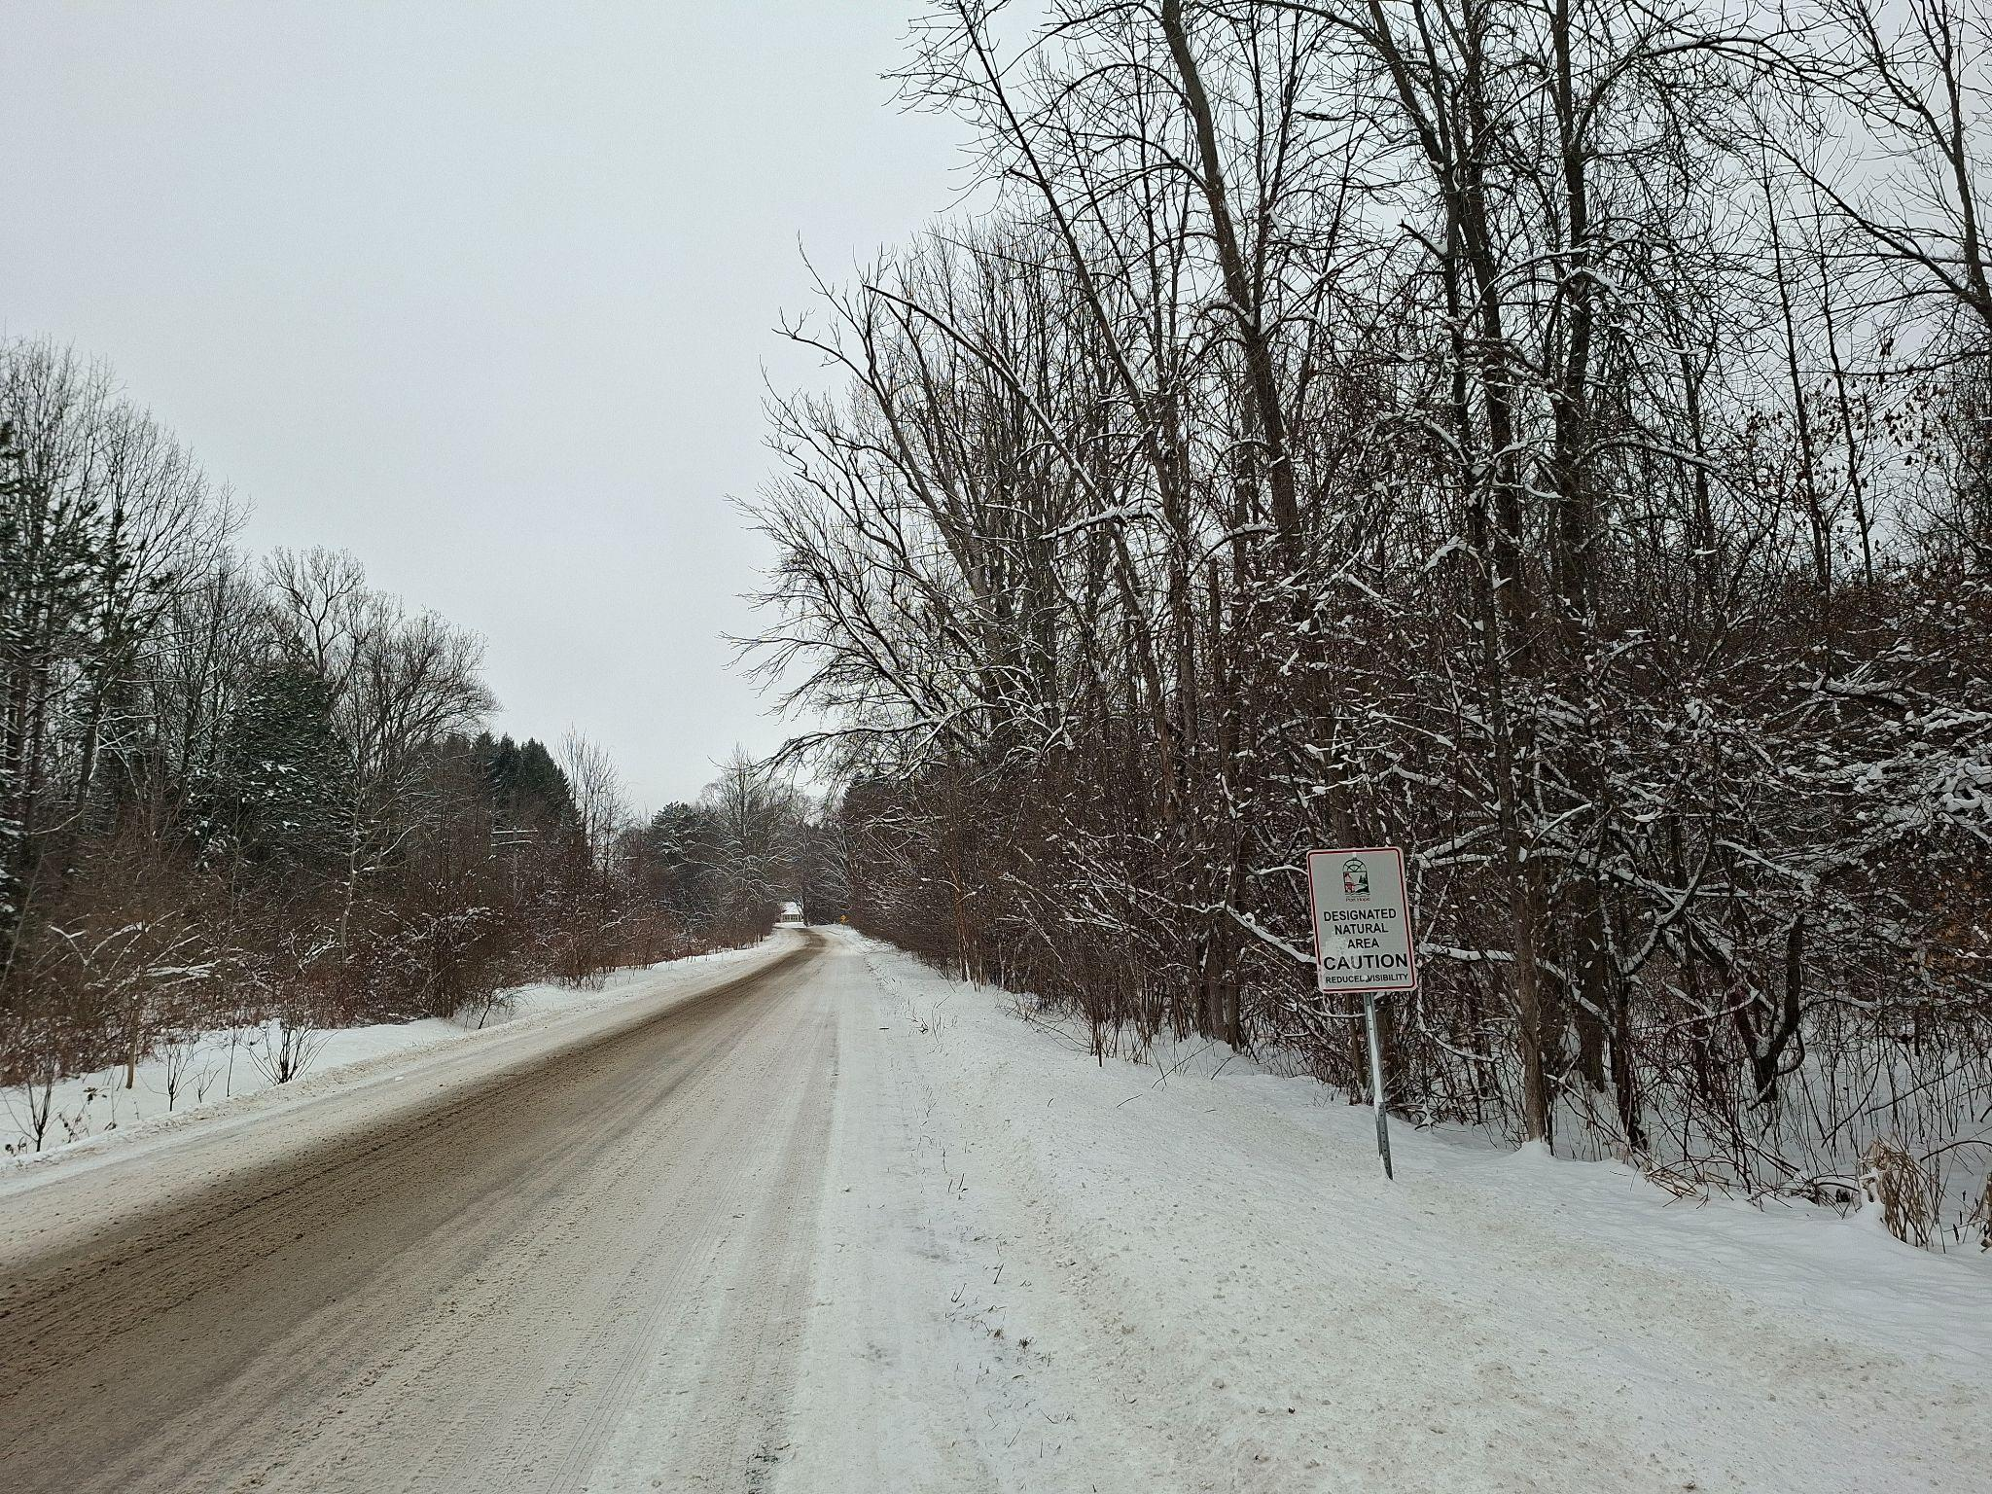
Thank you!
Thank you!
Wesleyville Lakeshore Rd, MPH Designated Natural Area Sign

Slide 21
1978 Federal EA Review Panel Refused Eldorado Nuclear UF6 Project at Port Granby
5 km west of Wesleyville
In 1978 after two years of study the federal Environmental Assessment Review Panel did not approve Eldorado Nuclear’s proposal to build a new uranium hexafluoride UF6 plant at Port Granby (less than 5 km west of Wesleyville on Lake Ontario) citing reasons including:
  location should not be used for industrial purposes, is an area with acres of high value agricultural land with suitable climate which Ontario needs to conserve,
has acres of protected species bio-diversity
objections of First Nations and area residents
did not approve Eldorado’s site waste storage plans due to geology, unproven technology proposed.

Slide 22
NO to More Nuclear in Port Hope (Wesleyville)
largest nuclear plant is high risk to people, environment
enriched U from US needed for SMRs, possibility here
impacts valuable farmland, Ontario losing average of 319 acres of farmland per day
impacts protected habitat areas
daily radioactive emissions to air, water, soil impacts health risks from inhalation, ingestion of particulate
produces high level waste needing transport, storage
high level target = high level security, emergency plans
truck transportation accident risks, disruptive, emissions
transmission wires, towers needed, more land
safer, cleaner, cheaper alternatives possible

Slide 23
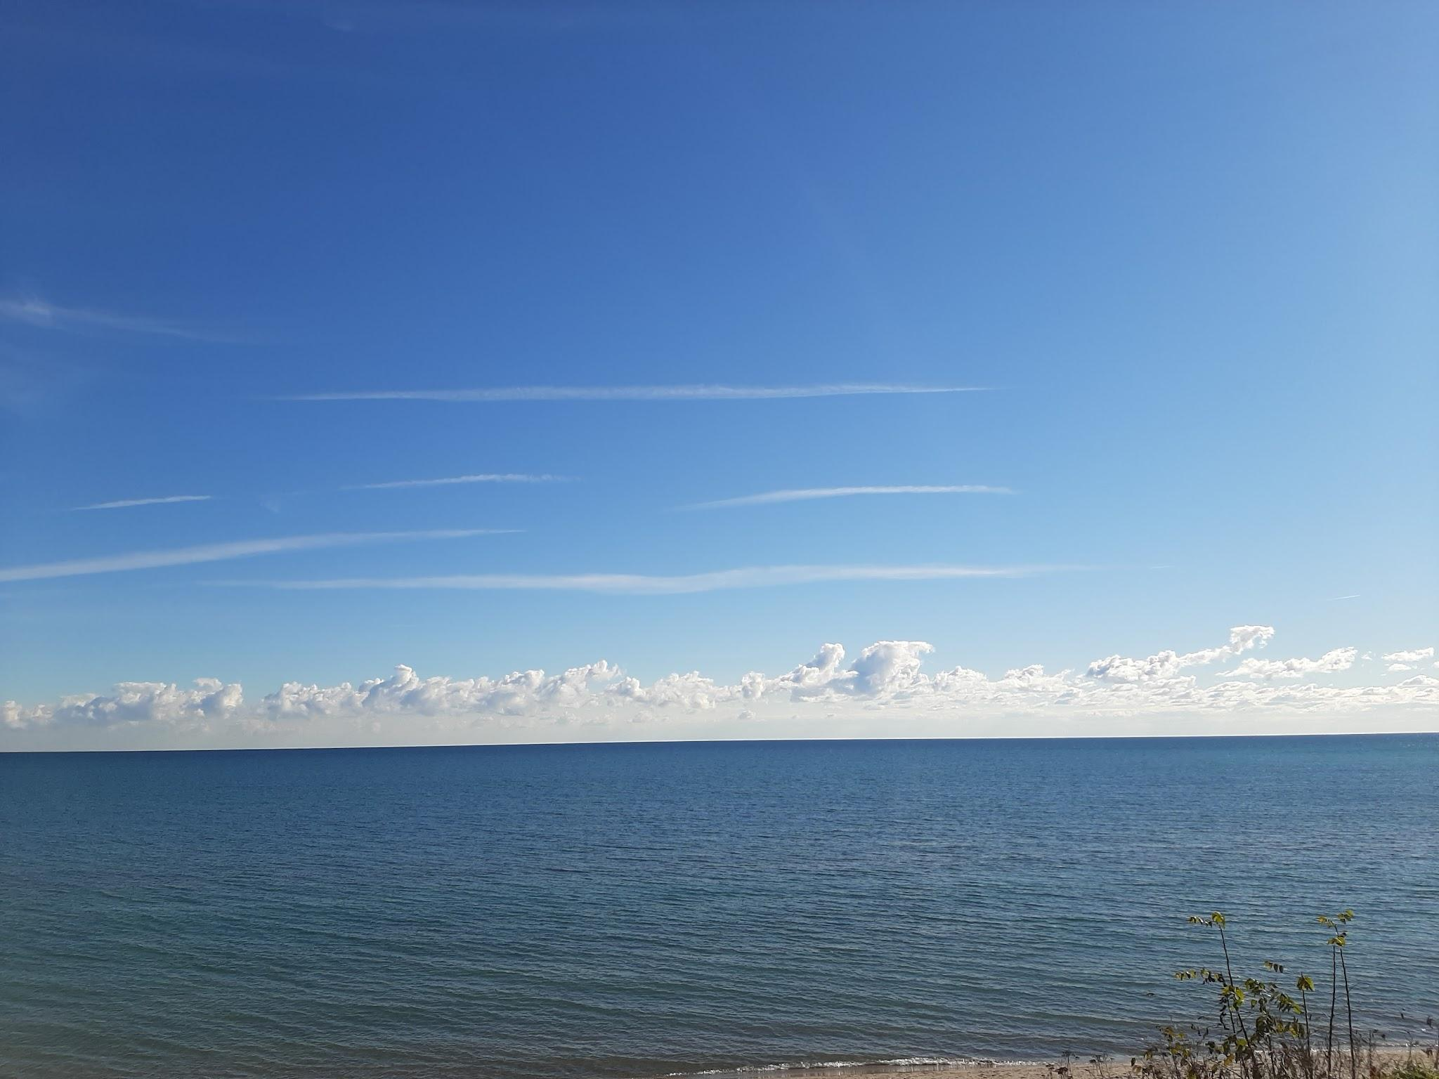
Thank you!
Beautiful Rural Port Hope on Lake Ontario

