Slide 1
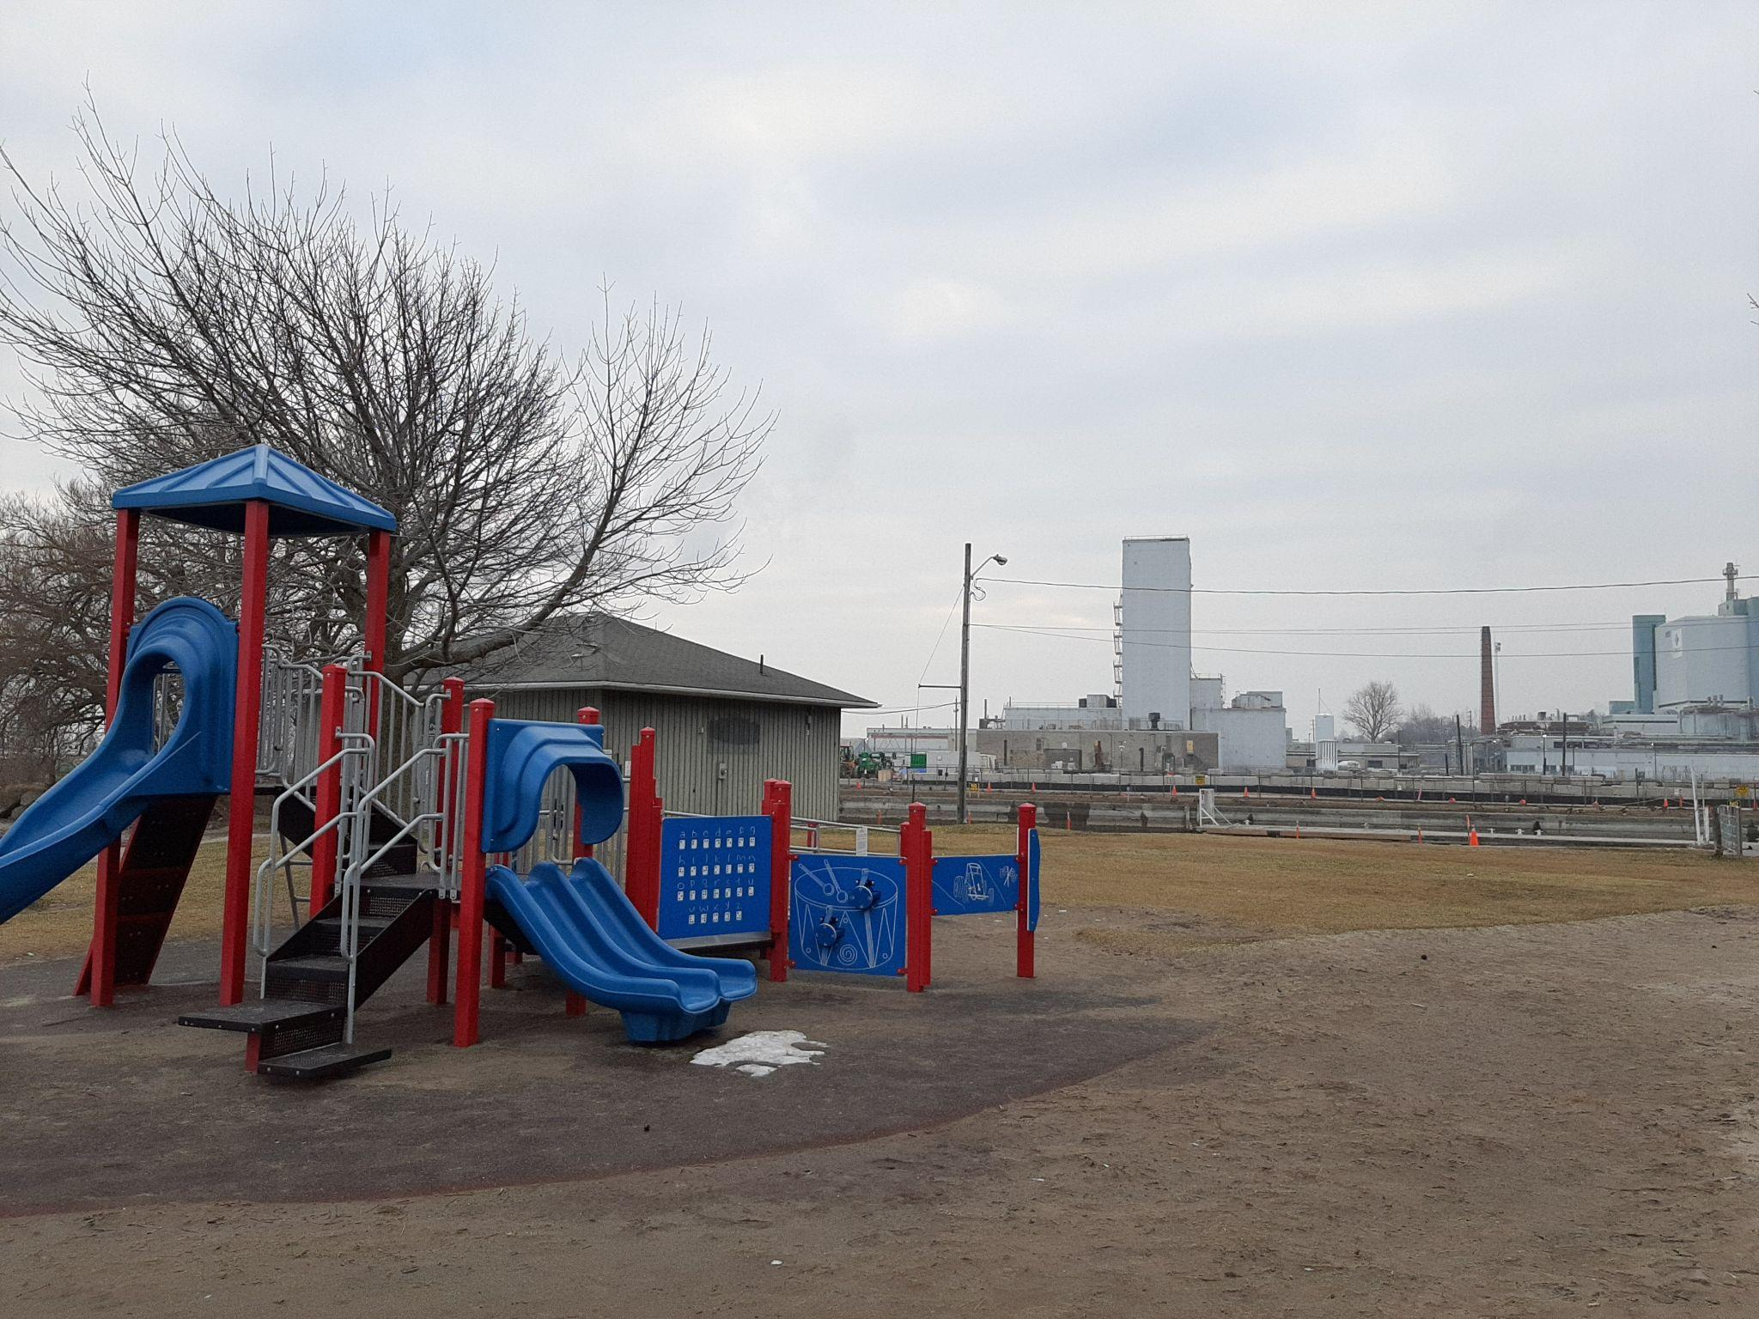
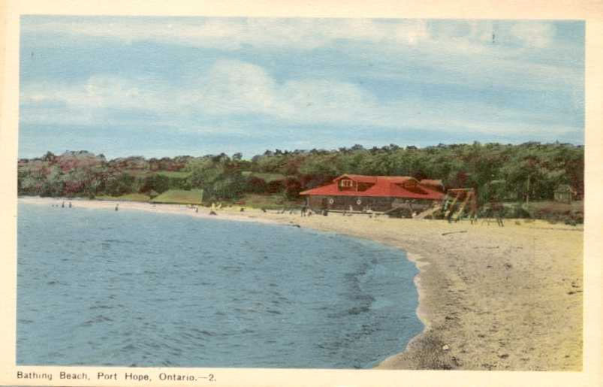
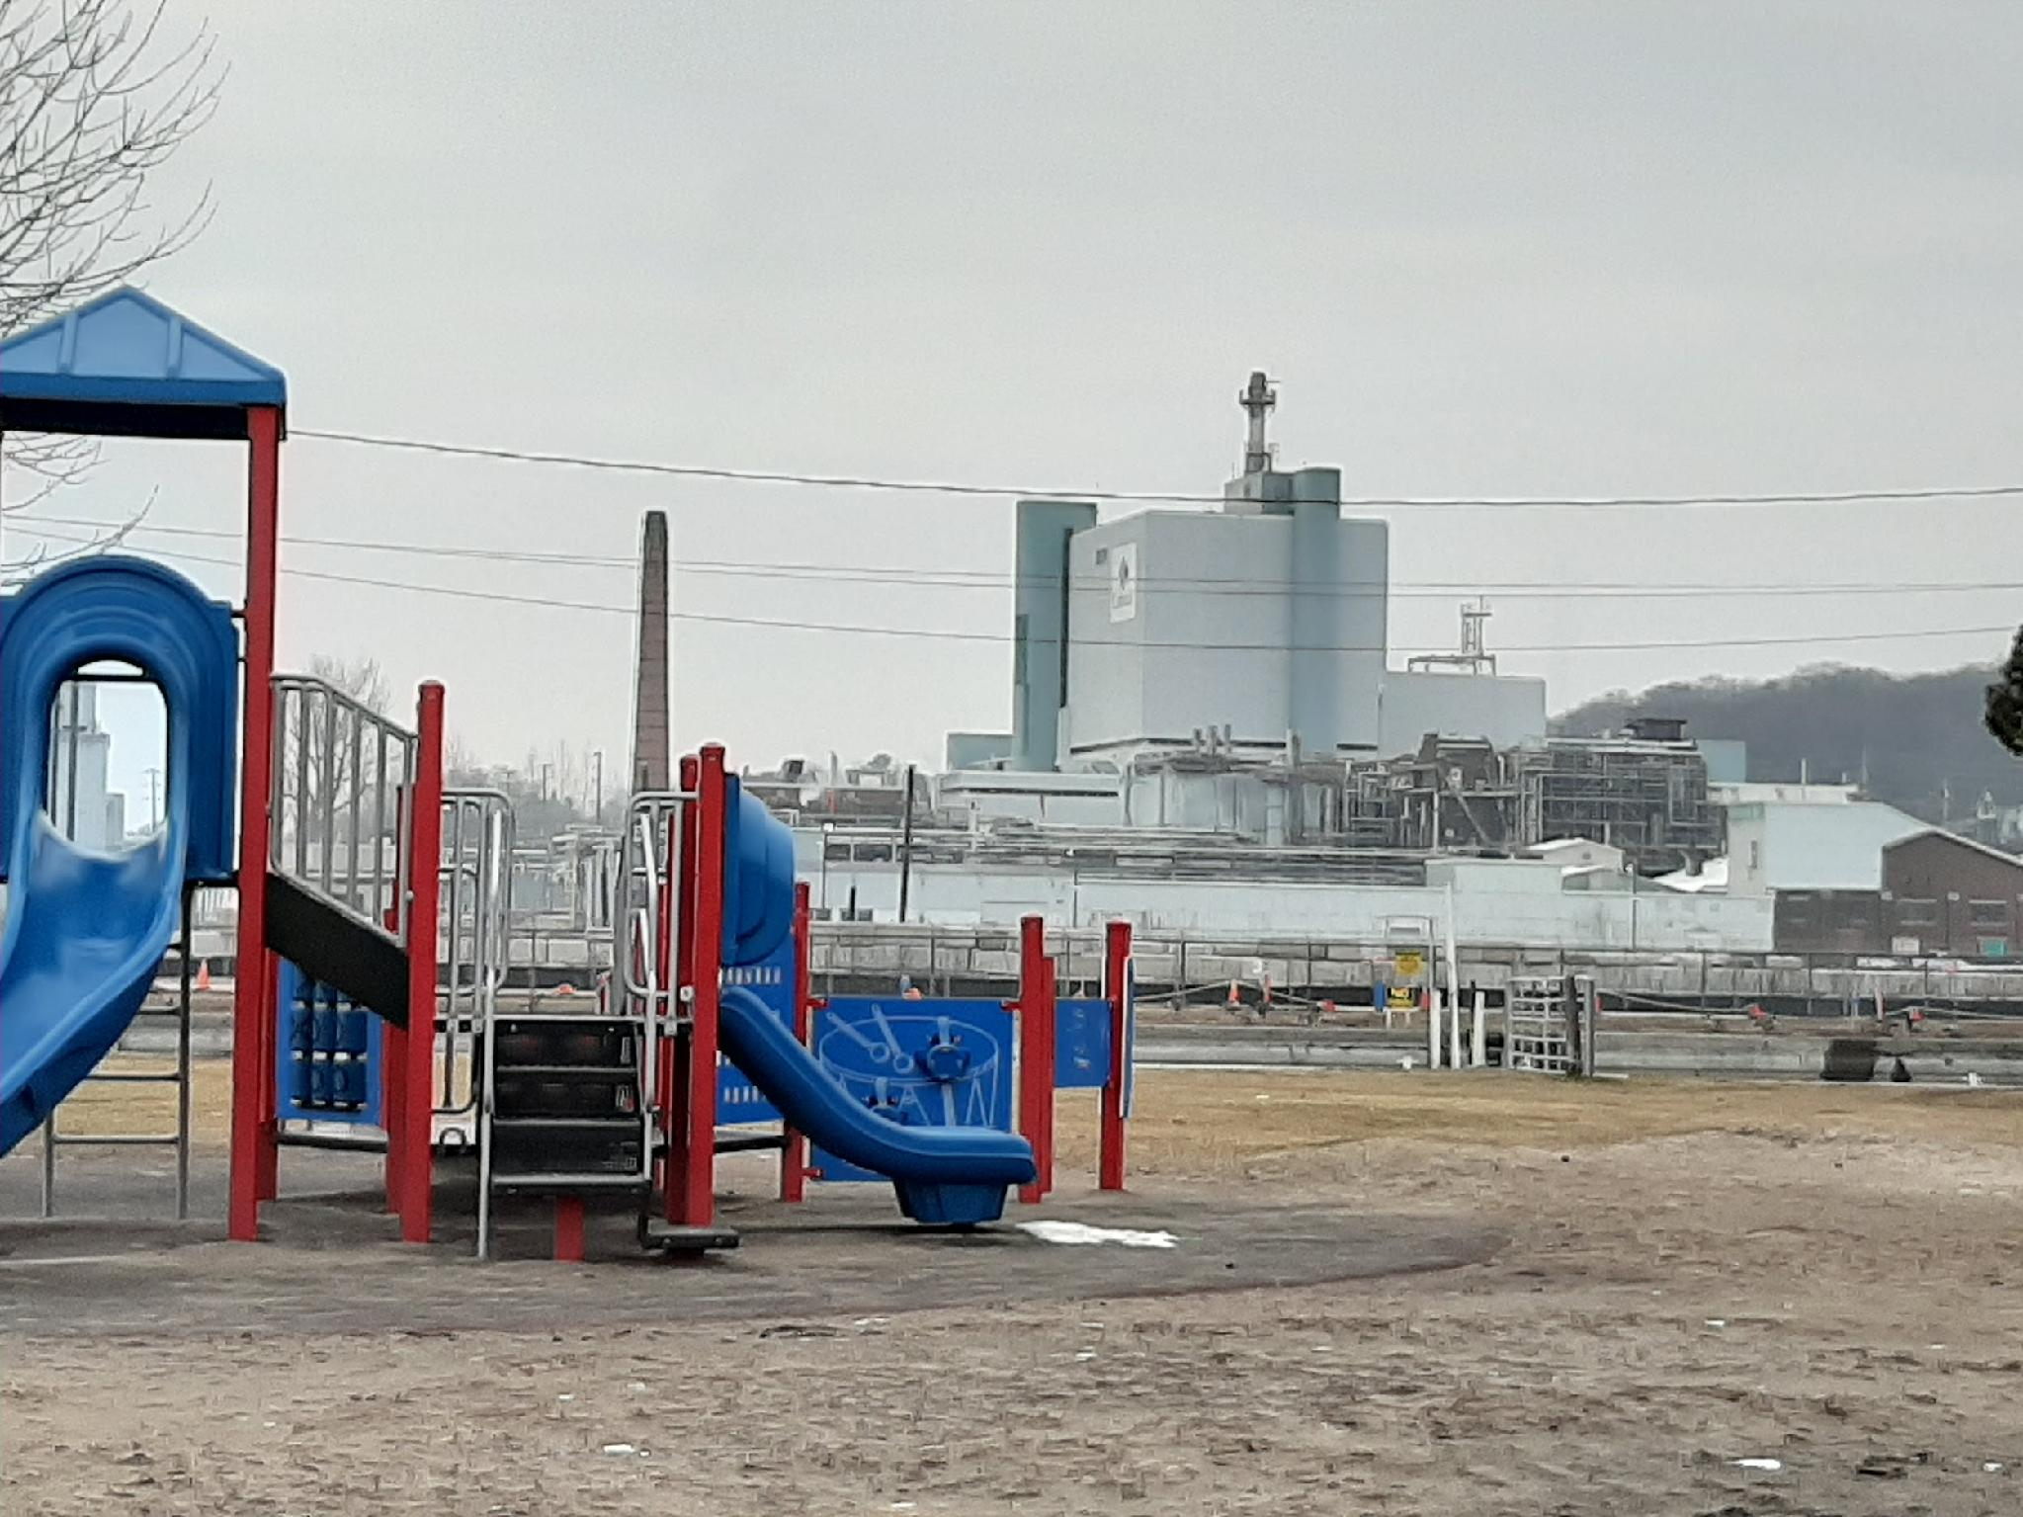
Nuclear Issues in Port Hope: Past, Present, Future
Presentation to Port Hope Council, July 21, 2026
Nuclear Waste Watch sponsor
"Nuclear Neighbours"
Presentation February 16, 2023
Port Hope Community Health Concerns Committee
Presentation by Faye More
Port Hope Community Health Concerns Committee
‹#›

Slide 2
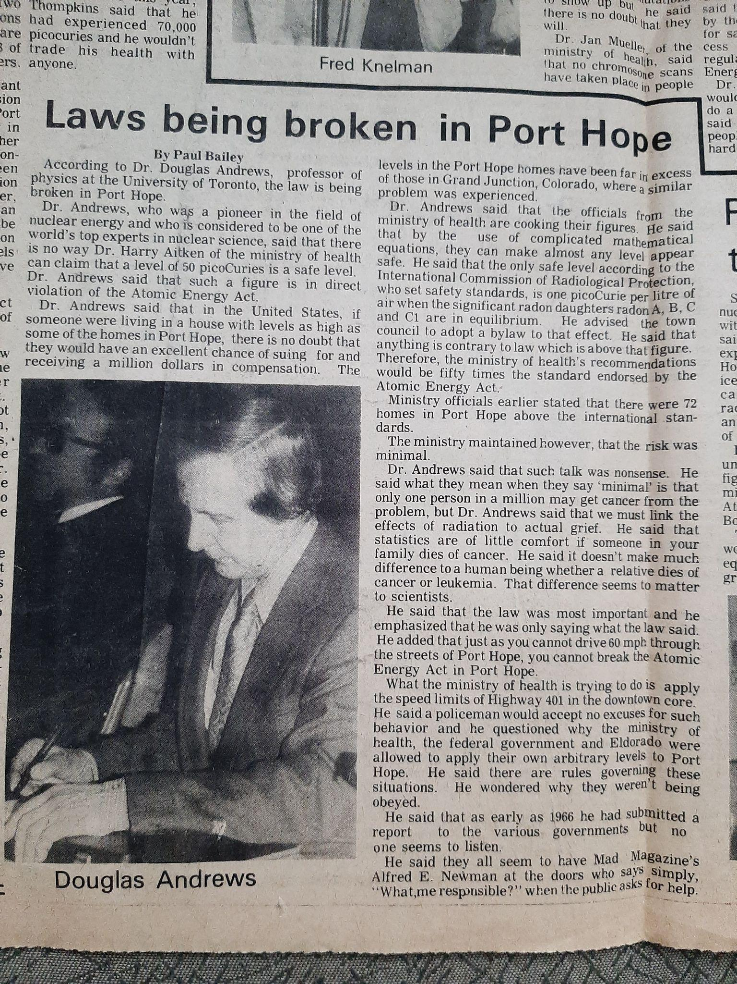
1976
Dr. Douglas Andrews
Nuclear Engineer,
U of T professor -
independent speaker at
first Port Hope public meeting, 1976, warned of the dangers.
For speaking up to protect Port Hope people Dr. Andrews
experienced harassment but he persisted on our behalf, also supporting a widow of an Eldorado employee in the 1940’s to receive compensation
from WCB after a 40 year battle.

Slide 3
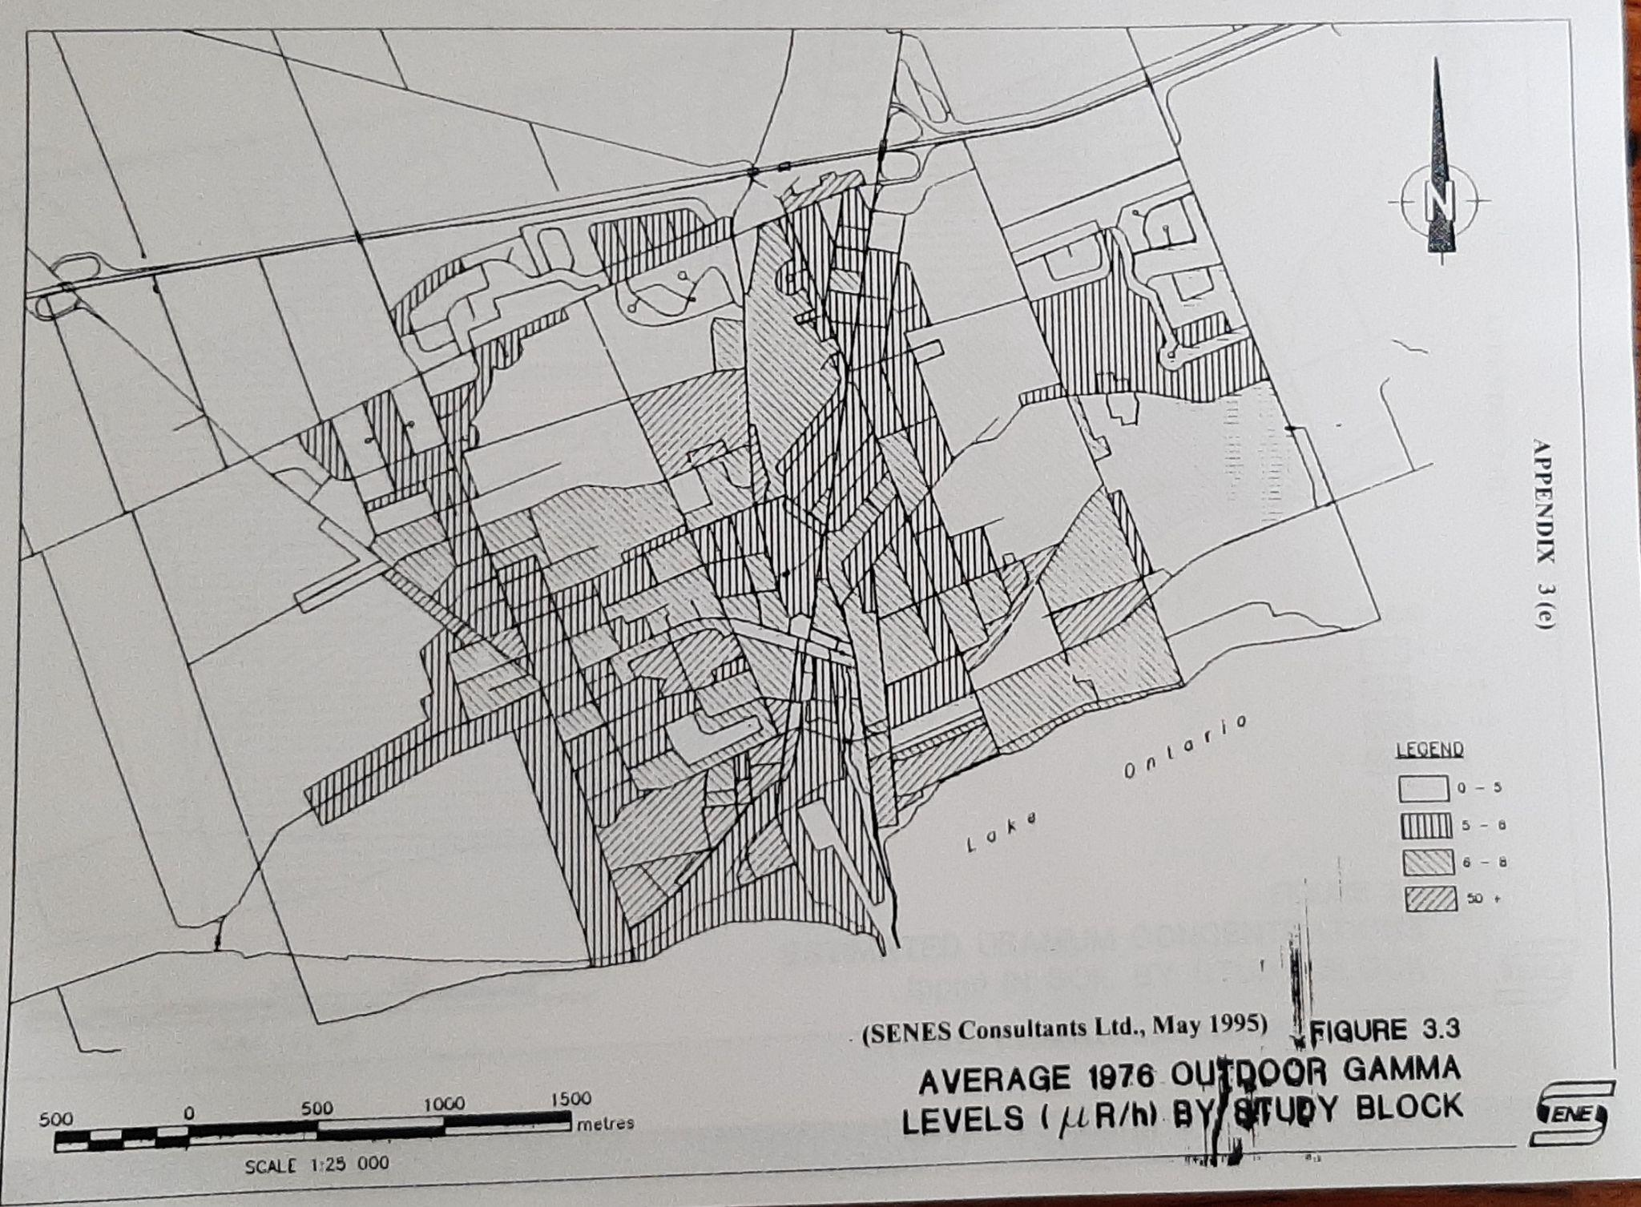
1976 Average outdoor gamma radiation

Slide 4
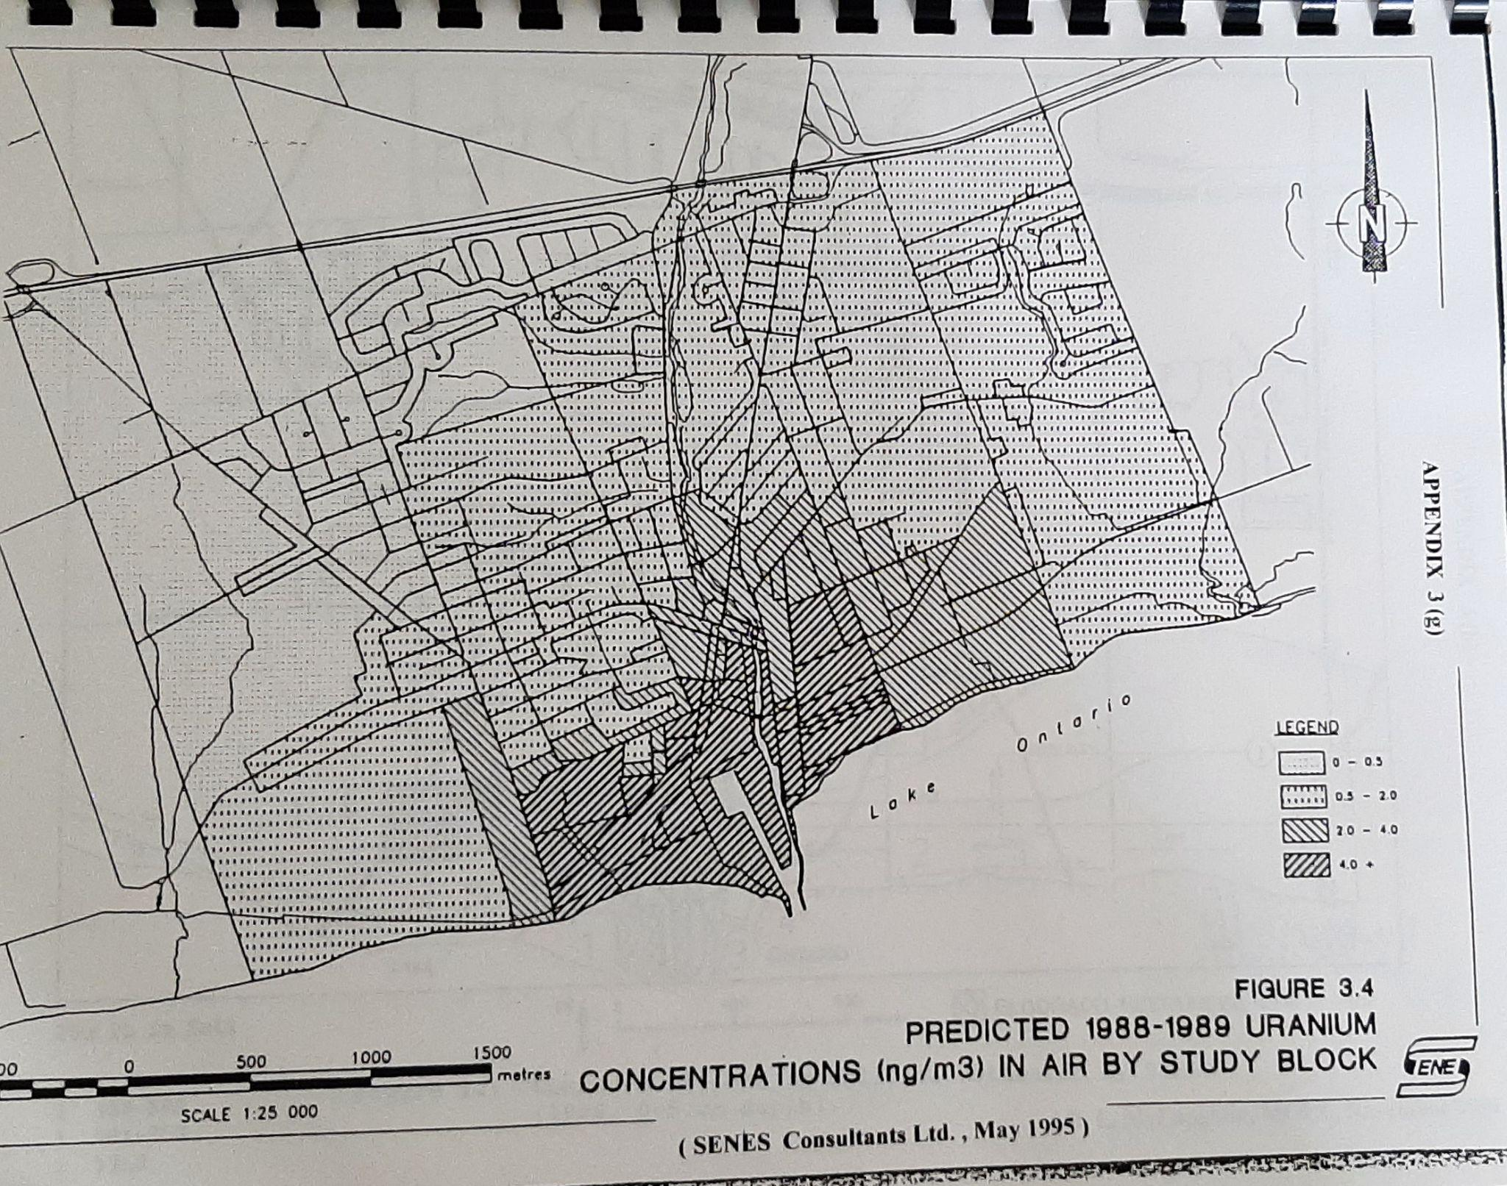
Predicted uranium concentrations in air 1985-1989

Slide 5
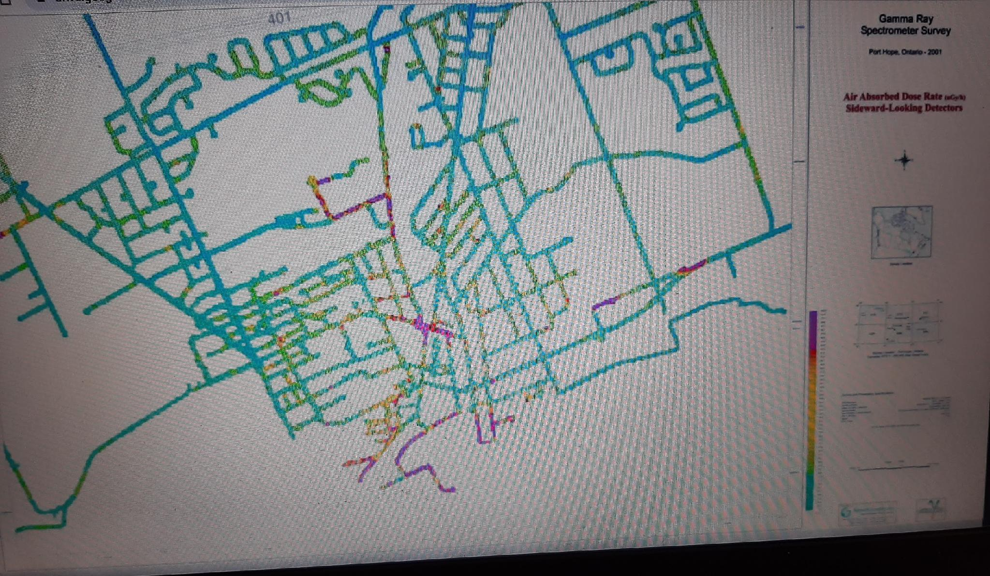
Air absorbed dose rate, gamma survey 2001

Slide 6
Health impacts of inhaled uranium-containing particles
Uranium-bearing respirable dust can cause various health problems, such as cardiovascular and neurological disorders, cancers, immunosuppression, and autoimmunity.
Exposure to elevated levels of uranium is linked to many such health conditions in Navajo Nation residents in northwestern New Mexico.
Most studies have focused on the fate of inhaled dust particles (<4 μm) in the lungs. However, larger-sized inhaled particles (10–20 μm) can be cleared to the human gastrointestinal tract (GIT), thereby enabling them to interact with stomach and intestinal fluids.
“The fate of inhaled uranium-containing particles upon clearance to gastrointestinal tract”
article by E. Hettiarachchi - published in Journal “Environmental Impacts: Processes & Impacts”, Issue 8, 2022, The Royal Society of Chemistry website

Slide 7
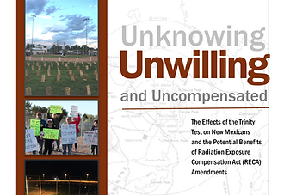
Tularosa Basin Downwinders Consortium
Seeking justice for the unknowing, unwilling and uncompensated, innocent victims of the July 16, 1945, Trinity test in South-Central New Mexico.
Film “First We Bombed New Mexico” - August 20, 2026 7 pm at Port Hope Lion’s Centre

Slide 8
Port Hope elevated rates of diseases:health outcome data
from 3 Health Canada studies 1997, 2000, 2002
Port Hope elevated for selected periods and cohorts for:
Overall death rate, circulatory disease, leukemia, non-Hodgkins lymphoma, cancers including childhood cancer deaths, and cancers of the lung, brain, nasal/sinus, esophageal, lip, bone, and colorectal.
2000, 2002 Health Canada/CNSC Data for Port Hope
(Peer reviewed by epidemiologist Dr. Eric Mintz, 2004)
Causes of death 1986-92 significantly higher than Ontario include:
hereditary, neurological, cardiovascular, respiratory diseases; cancers, including lip and oral cavity, pharynx, gallbladder, lung, trachea, bronchus, bone.
1998 Health Canada Great Lakes Health Effects Program Health Study
on the Population Around Port Hope Harbour
‹#›

Slide 9
Dr. Eric Mintz Peer Review of Health Canada data
2000, 2002 for Port Hope
…the patterns of several cancer rates show cause for concern in that the patterns are consistent with environmental contamination.
Certainly the raised leukemia rates, which were even higher before remediation are not reassuring.
100 more female deaths than expected in the 1986-97 period due to circulatory disease…surprise finding requires further scrutiny.
Findings suggest children experienced high cancer rates, particularly before 1986.
The findings taken together show a pattern that is quite suggestive of an excess of brain cancer in Port Hope.
Along with the brain cancer, colon cancer and some of the rare cancer results, the available evidence points to there being problems in Port Hope.
Epidemiologist Dr. Eric Mintz, 2004
‹#›

Slide 10
2007 - Cleanup criteria and Special Circumstances:
Council enforcing the Legal Agreement with Canada
Tularosa Basin Downwinders Consortium
Seeking justice for the unknowing, unwilling and uncompensated, innocent victims of the July 16, 1945, Trinity test in South-Central New Mexico.
“We discussed the expectation of the Municipality for a full cleanup to the agreed upon cleanup criteria at all sites in Port Hope unless there is Municipal consent to do otherwise.
…my view is that this (i.e. relying on risk assessment recommendations) deviates from the agreement on cleanup criteria and from the Legal Agreement.
The Municipal position continues to be that all contaminated sites, including Sculthorpe Marsh and Highland Drive landfill, must be cleaned up to the full criteria. While the cleanup criteria principles include special circumstances, the aforementioned were not considered to be a special circumstance.
I advised a clear rationale needs to be provided to the Municipality if any alternative to the application of the cleanup criteria is to be considered.”
excerpts from letter dated March 19, 2007 from Port Hope Mayor Linda Thompson to Dr. Peter Brown, Natural Resources Canada.

Slide 11
AECL/CNL proposal to change arsenic remediation criteria
The 4 Signature Contaminants of Potential Concern (COPCs) for CNL/PHAI investigations are
Arsenic, Uranium, Radium 226. Thorium
Cleanup criteria for the COPCs in Port Hope were agreed upon after extensive government and community deliberations. The current remediation criteria for arsenic is 18 ppm.
Since 2017, the beginning of private property remediations, CNL has proposed arsenic remediation change to 50-55 ppm.
Health Canada has not agreed.
MPH Council agreed in October 2024
“Inorganic arsenic is the form of primary toxicological concern in humans.
- The group of inorganic arsenic compounds as a whole is therefore considered to be a non-threshold toxicant i.e. a substance for which there is believed to be some chance of adverse health effects at any level of exposure.”
Canadian Soil Quality Guidelines for the Protection of Environmental and Human Health

Slide 12
No federal health follow-up
Federal commitments to Port Hope dating from 1979 public announcements for $5 million health investigations - not done
The Lees Study (Queen’s University, 1983) – showed association of radon and lung cancer in small Port Hope study (25) – no follow-up
Health Canada PH Harbour Area of Concern Report (1997), Health Canada data 2000, 2002 – elevated rates of cancers, neurological, cardiovascular, respiratory, – no follow-up
Community Health Survey Design – created by York U Professor with promise of funding by AECB, not implemented
Pilot Tracking Study – promised by AECB, not implemented
Childhood Kidney Function Bio-testing –promised by AECB, not implemented
UMRC-PHCHCC human radiobiological testing results showing 236U, DU, elevated 234U ndustrial U in PH subjects– no followup, findings not included in CNSC’s Synthesis Report
CNSC and Health Canada conclude no health studies are necessary just before the community was to begin a $2.6B cleanup with two nuclear facilities operating in town.
‹#›
‹#›

Slide 13
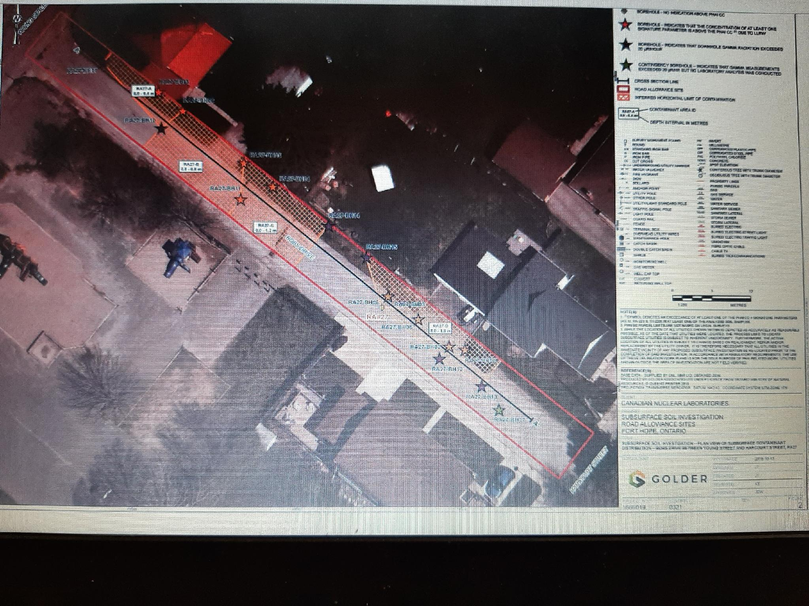
Bob’s Drive contaminated roadway to contaminated former
Dr. Power’s School playground

Slide 14
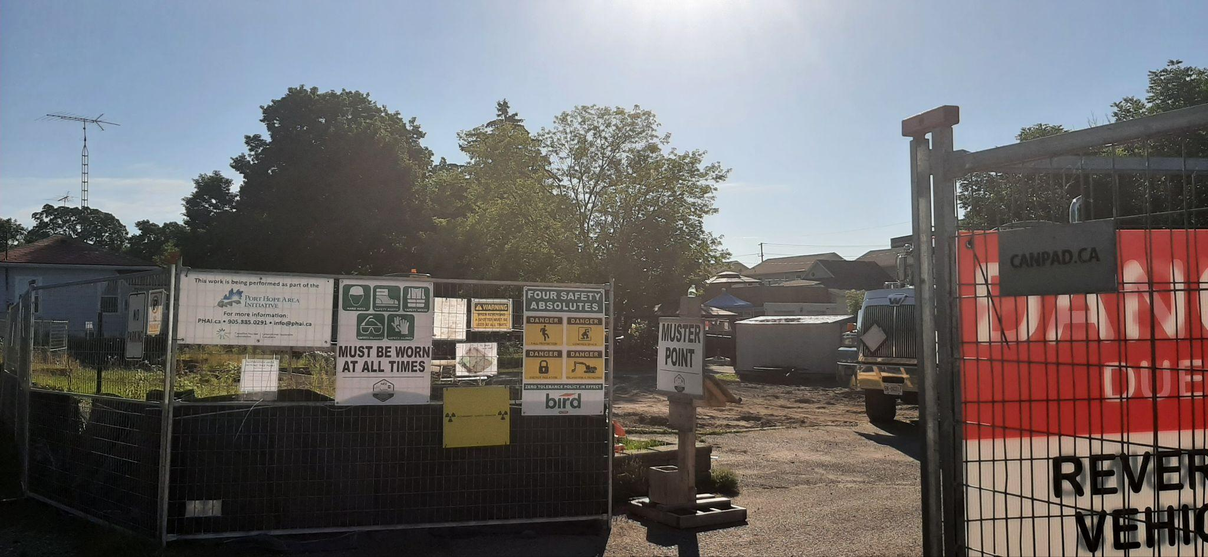
Radioactive waste remediation underway at former Dr. Power’s Public School playground on Bob’s Drive 2024

Slide 15
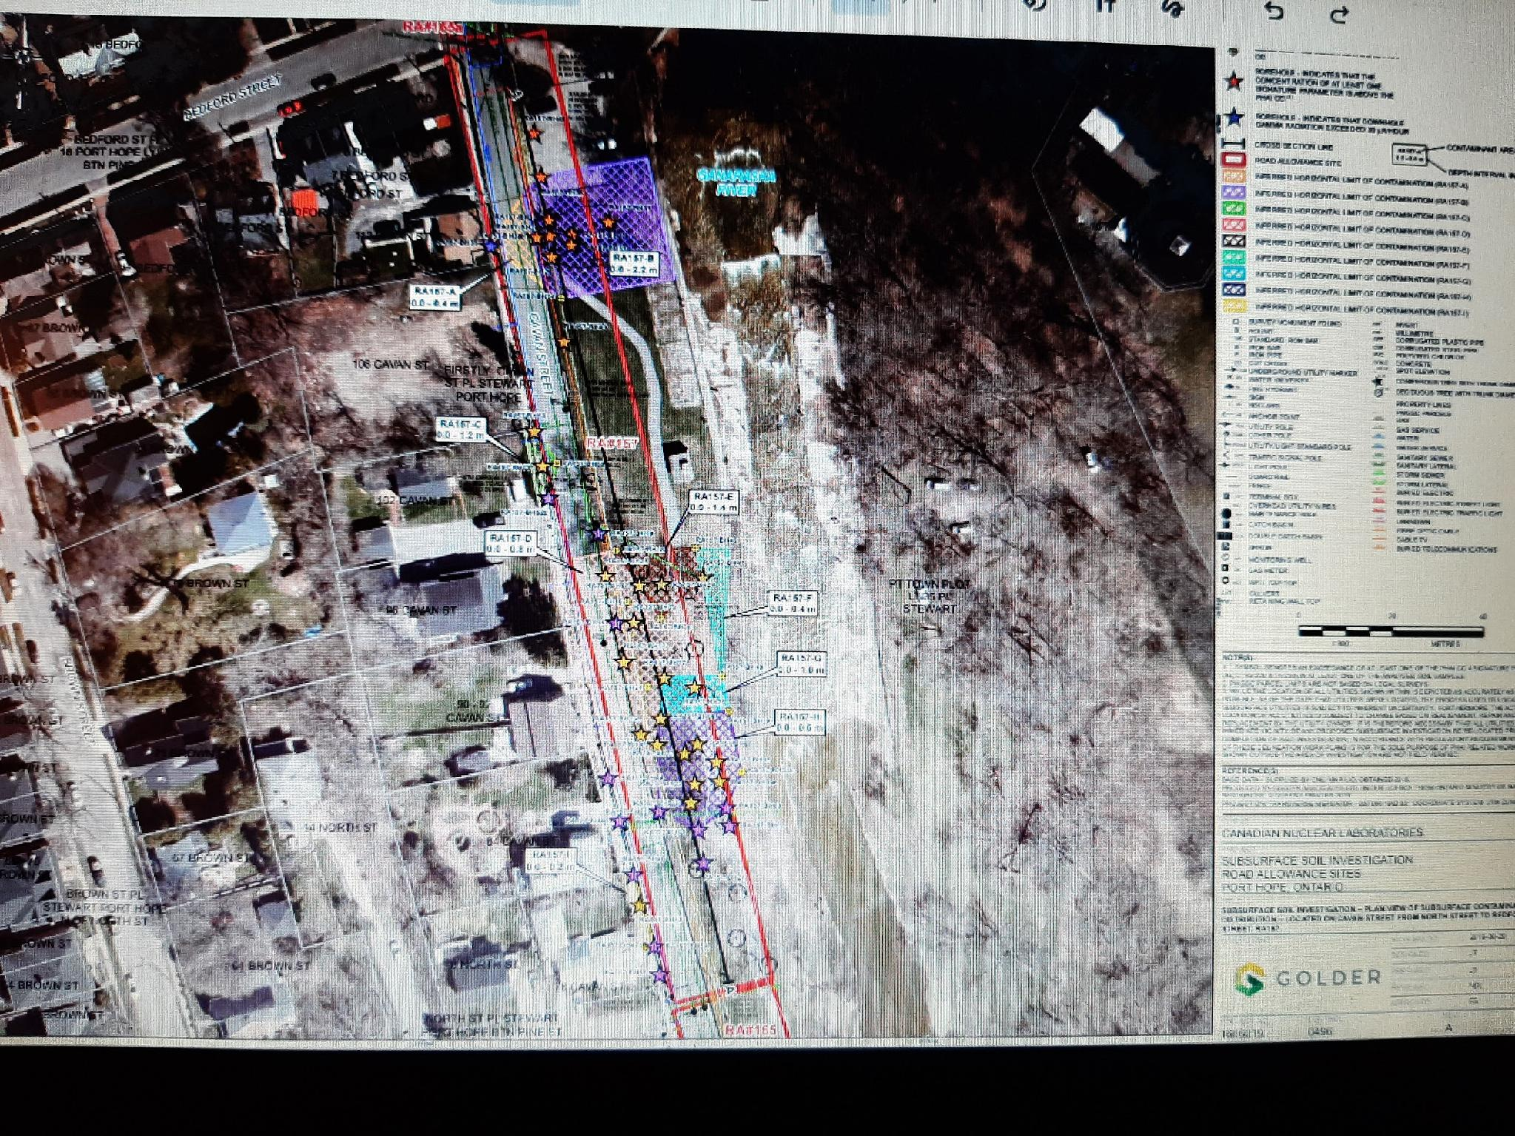
Source AECL ATIP 2022 public municipal roads and frontages data. Borehole test results show contamination along Cavan Street below Highland Drive landfill, beside Ganaraska Rive

Slide 16
Key Issues Today
OPG proposal for world’s largest nuclear reactor site in Port Hope
$2.6 + billion remediation is now voluntary
Property owners direct remediation decisions, can deny property access
Property investigations not happening as intended for full cleanup
Tree canopy is now top priority with Council & CNL
Council approved arsenic criteria change. Health Canada has not.
Unknown volume/content of wastes to remain around town
Health and safety now & in future cannot be assured
Contaminated properties may need CNSC license or be exempted
New AECL agreements encourage wastes to be left in place
New AECL agreements impose new costs on residents, exclude arsenic
Facility space for 100 years not credible given 300% more volume discovered at small sites - 1160 sites remaining.
No CAC or public consultation/participation as intended in 2001 LA
No legal or technical advocacy for residents
Restricted access to reports, research relating to CNL activities
Many resident concerns now & for future unaddressed
Still no health monitoring of individuals, families, community
No compensation directly for current and former residents
Two Cameco nuclear facilities operating without buffer zones

Slide 17
Petition to the Auditor General of Canada, June 2026
Proactive disclosure of contaminated public use properties - roads, frontages, parks, beaches
Bill c-226 - No new nuclear facility in Port Hope
National public inquiry of radioactive waste management in Canada starting with Port Hope
Adhere to the remediation 2001 Legal Agreement - financial-operational audit of AECL/CNL/PHAI
Comprehensive health monitoring of residents
Compensation for current and former Port Hope families

Slide 18
Proactive Disclosure of Contaminated Public Properties
Q 1: Will the federal government investigate the three property examples described and publicly report findings of why officials repeatedly failed to disclose information showing the presence of contamination and need for remediation to property occupants, owners, families, students and the public and hold officials accountable?
Q 2: Will radiation/ danger signs be posted on all contaminated public properties and identified on the PHAI website?
Q.3. Will the federal government ensure policies and practices are changed to proactive sharing of specific site information regarding contamination in the Port Hope environment rather than placing the burden and costs onto the public to ask under Access to Information Laws for information they don’t know exists? For example, will municipal roads and frontages contamination be included in adjacent private property property files?

Slide 19
Bill c-226 Environmental Injustice
NO to OPG Plan for new nuclear in Port Hope
Q 4. Will the federal government acknowledge the disproportionate nuclear industry burden on the community of Port Hope, apply the protections of Bill c-226 to Port Hope’s current situation of environmental injustice and act to have the IAAC Assessment underway for OPG’s New Nuclear at Wesleyville Proposal cancelled and the site deemed not appropriate?
Procedural Justice: “means people must have fair access to decisions that affect their environment”
Recognitional Justice: “means policies should respect the experiences, values, and histories of affected communities, especially those facing systemic racism”
Distributive Justice: “means environmental harms and benefits should be shared fairly across all communities”
source Canada.ca , Environment and Climate Change Canada

Slide 20
National Public Inquiry into Radioactive Waste Management in Canada
Q 5: Will the federal government establish a National Public Inquiry to examine current and future radioactive waste management in Canada that will aid all responsible government departments and industry to understand what is happening at key locations in Canada and to collaborate with the public on precautionary solutions that comply with Agreements, Treaties, laws and honour historical commitments to the people?
Note: starting with Port Hope’s past, present, future

Slide 21
Adhere to the Canada/Port Hope Legal Agreement - Comprehensive Audit of AECL/CNL/PHAI
Q 6: Will the federal government implement a comprehensive operational and financial audit of the AECL/CNL policies and practices since 2015 to 1) ensure adherence to the provisions of the Legal Agreement between Canada and Port Hope (2001) including examining CNSC, Natural Resources Canada, Municipal and public roles, responsibilities and current/future liabilities and 2) will address all of the remediation issues identified in this Petition to support and protect current and future residents of Port Hope.
Issues: plan to weaken cleanup criteria for arsenic and uranium, Special Circumstances Protocol removed Municipal role from private properties, created voluntary remediation option, no resident CAC or support, restricted information access, limited peer reviews, no compensation, no health monitoring, cost-savings for CNL a priority,
Need resident -based CAC, legal & case management advocacy and compensation for residents, honour the Legal Agreement.

Slide 22
Comprehensive health monitoring of residents
Q.7 Will the federal government require and fund independent, multi-disciplinary health monitoring of the Port Hope community including re-analysis of previous Port Hope health studies, health surveys, followup investigations and bio-testing?
Q.8 In addition to the above, will the federal government require independent health monitoring in the same manner as Nuclear Energy Workers, using criteria for Non-NEW of individual residents in Port Hope who are 1) are or have been directly impacted by the presence of contamination in their immediate environment or 2) by remediation of their own or a neighbouring public or private property or 3) live, work or attend school within a 500 metre radius of the two Cameco facilities?

Slide 23
Federal compensation for current and former
Port Hope families
Q 9. Will the federal government enact legislation modelled on the U.S. that recognizes and directly compensates military personnel, nuclear energy workers and community down-winders for harms caused by exposures to nuclear industry contaminants?
Note: To date, under U.S. legislation more than $30 billion paid under the Radiation Exposure Compensation Act and the Energy Employees Occupational Illness Compensation Act.

Slide 24
Bill c-226 Supports Petition
It is our contention that Bill c-226 “National Strategy Respecting Environmental Racism and Environmental Justice Act” supports all of our requests and recommendations in our Petition:
“Measures that can be taken to advance environmental justice and assess, prevent and address environmental racism and that may include
Possible amendments to federal laws, policies and programs
The involvement of community groups in environmental policy making
Compensation for individuals or communities and
The collection of information and statistics relating to health outcomes in communities located in proximity to environmental hazards”.

Slide 25
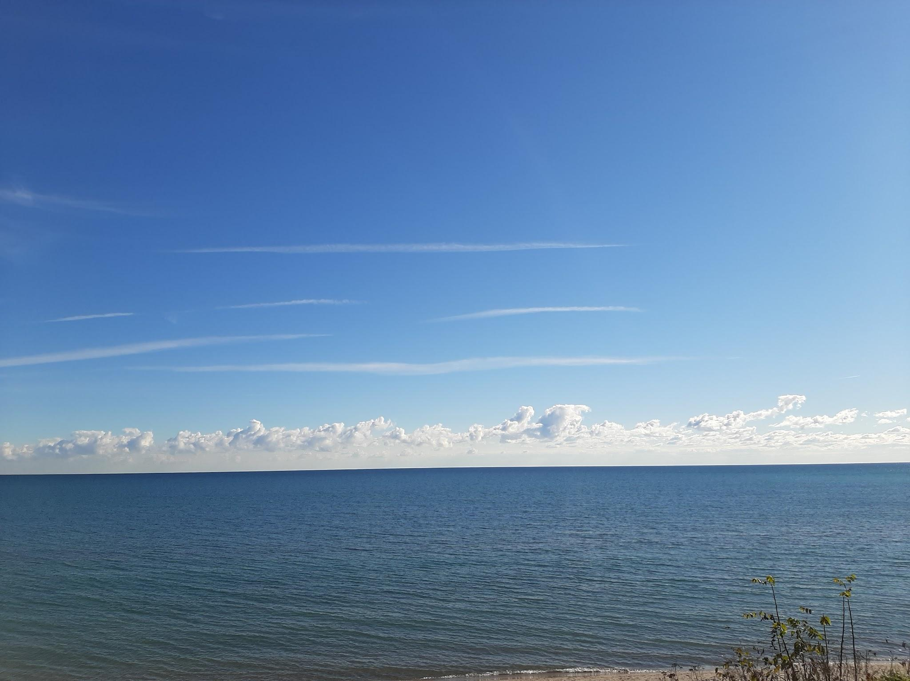
Thank you!
Beautiful Wesleyville, Port Hope on Lake Ontario

